Slide 1
Breakout reference slides!
UNIT 8
Scroll through these slides, which are the same ones from live session that are on the topic of hypothesis tests for the correlation coefficient.
(Hit the arrows below the slides to advance the slides.)

Slide 2
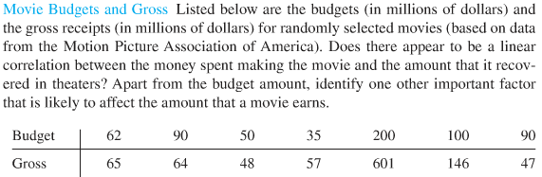
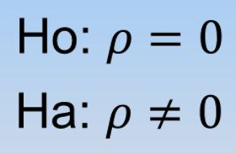
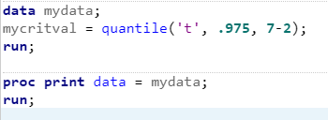

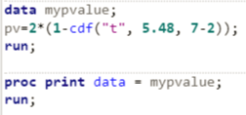

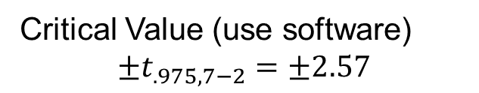

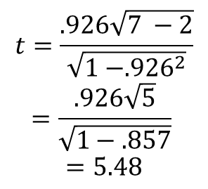
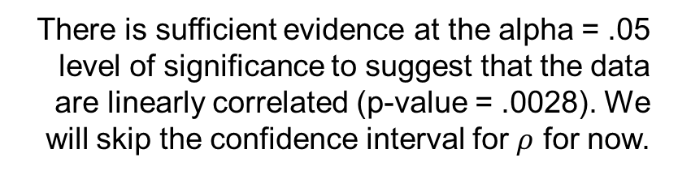
Movies!!! (for reference)
$$\frac{r\sqrt{n −2}}{\sqrt{1 −r^{2}}}\sim t_{n−2}$$
There is sufficient evidence at the alpha = .05 level of significance to suggest that the data are linearly correlated (p-value = .0028). We will skip the confidence interval for $ρ$ for now.
Critical Value (use software)
$$±t_{.975, 7−2}=±2.57$$
It is estimated that r² = 85.7% of the variation in the Gross Sales is explained by the Movie Budget!
Test statistic
$$t=\frac{.926\sqrt{7 −2}}{\sqrt{1 −{.926}^{2}}}$$
$$=\frac{.926\sqrt{5}}{\sqrt{1−.857}}$$
$$=5.48$$
Because the data is randomly selected, the results can be generalized to the entire population of movies associated with the MPAA. Because the budgets were not randomly assigned, causality cannot be established, only association.
P-value =.0028
(use software if the t-value is calculated “by hand”)
Other factors that affect gross sales may include the type of movie, the actors in the movie, etc.
Reject H_{o}

Slide 3
The next slide is a reference for the second breakout session

Slide 4
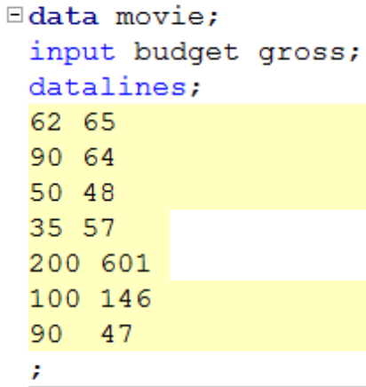
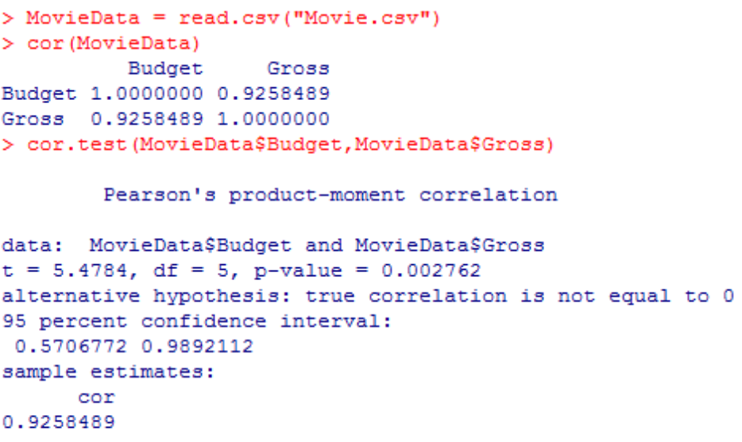


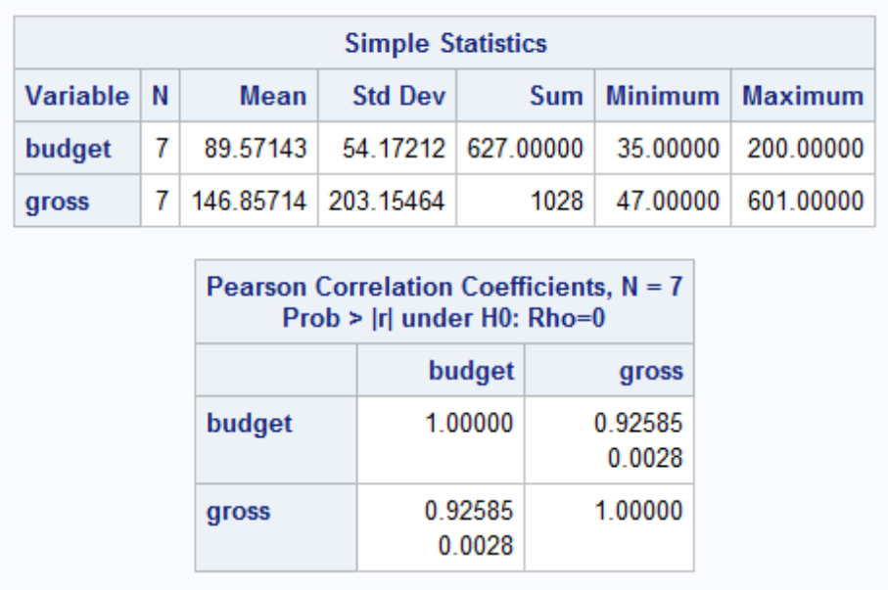
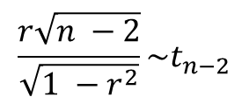
SAS and r: Movie Data (for reference)
$$\frac{r\sqrt{n −2}}{\sqrt{1 −r^{2}}}\sim t_{n−2}$$
P-value
Sample Correlation Coefficient r

